Slide 1
Master’s Research Project - 05
Strategic Planning for Medical Equipment Utilization
Narendra Ogety
Hari Teja Nalluri
Likitha Boppana
Manasa Chowdary Yalamanchili
Sesha Sai Meka

Slide 2
📊 Project Overview
Objective: Optimize medical device utilization in healthcare facilities
User: Healthcare Administrator
Data Source: Synthea synthetic patient data
Platform: Power BI

Slide 3
📈 Dashboard Features
Devices Used, Procedures Performed, Facilities Count (KPIs)
Bar charts for device demand and utilization
Forecast chart for future device needs
Interactive slicers and drillthroughs

Slide 4
Requirements & Validation
Each visual aligns with project charter requirements
Validation performed using filters, DAX, and raw data checks
Forecasting chart uses START year from Synthea data
All outputs derived from Synthea database

Slide 5
🏥 Benefits to Healthcare Administrators
Identify high-demand and underutilized devices
Plan resource allocation effectively
Understand demographic and location-based usage patterns
Forecast future needs for strategic planning

Slide 6
🎯 Conclusion
The dashboard meets all project requirements
Data is fully sourced from Synthea
Provides clear, validated, and actionable insights
Supports data-driven healthcare decisions

Slide 7
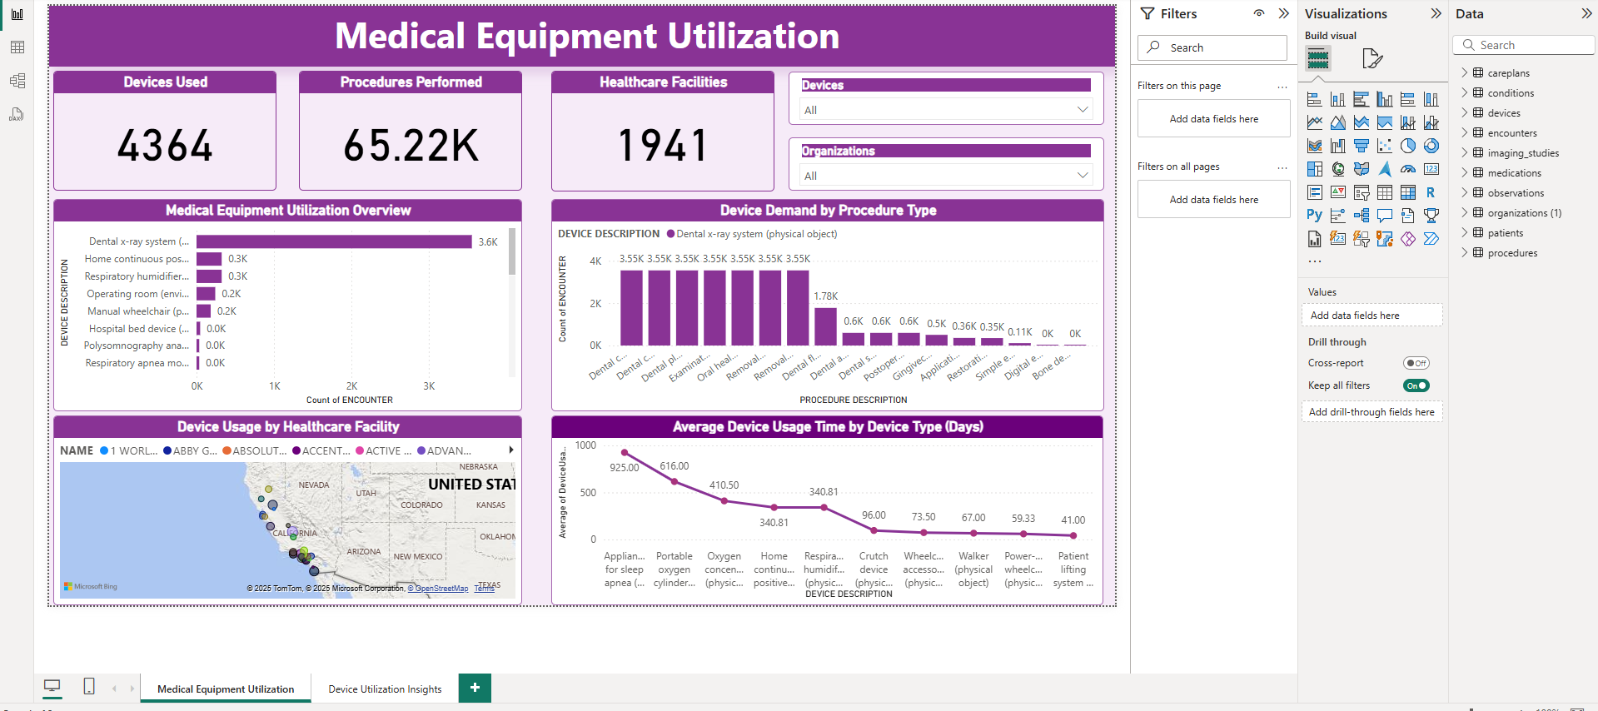
Medical Equipment Utilization Dashboard

Slide 8
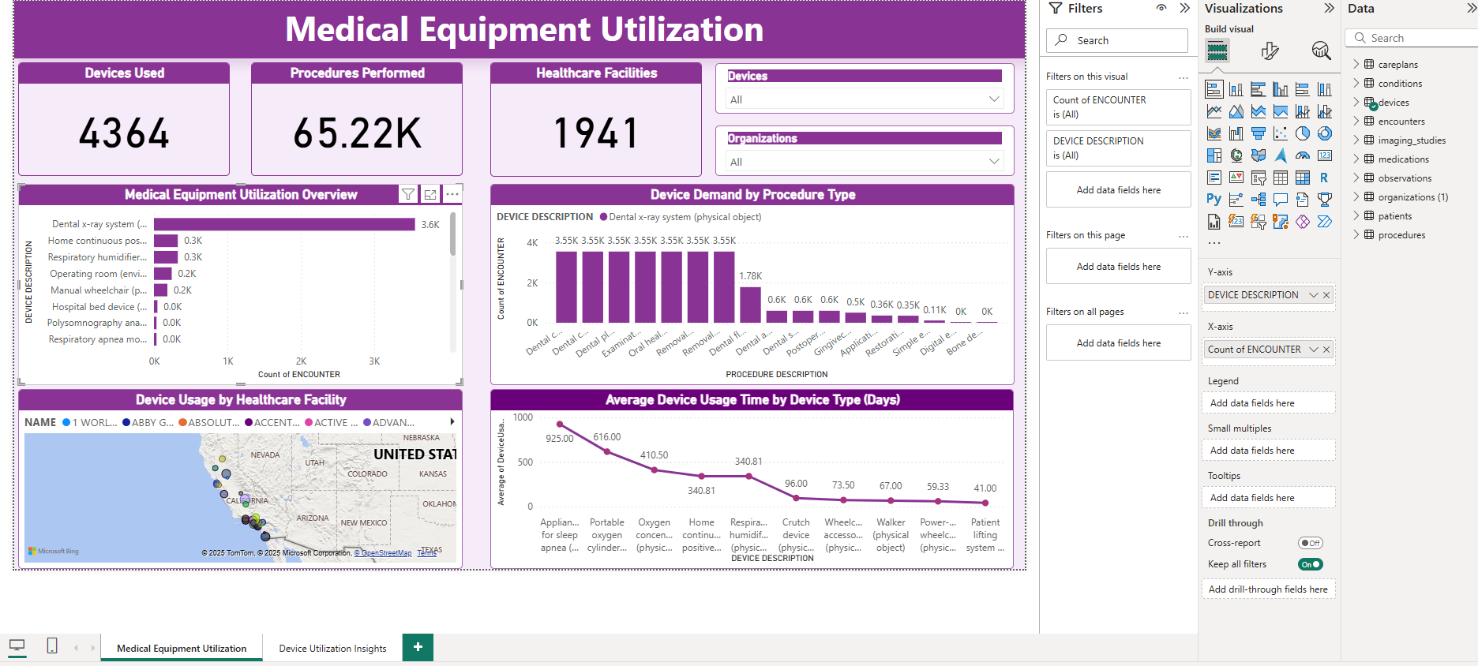
Medical Equipment Utilization Overview

Slide 9
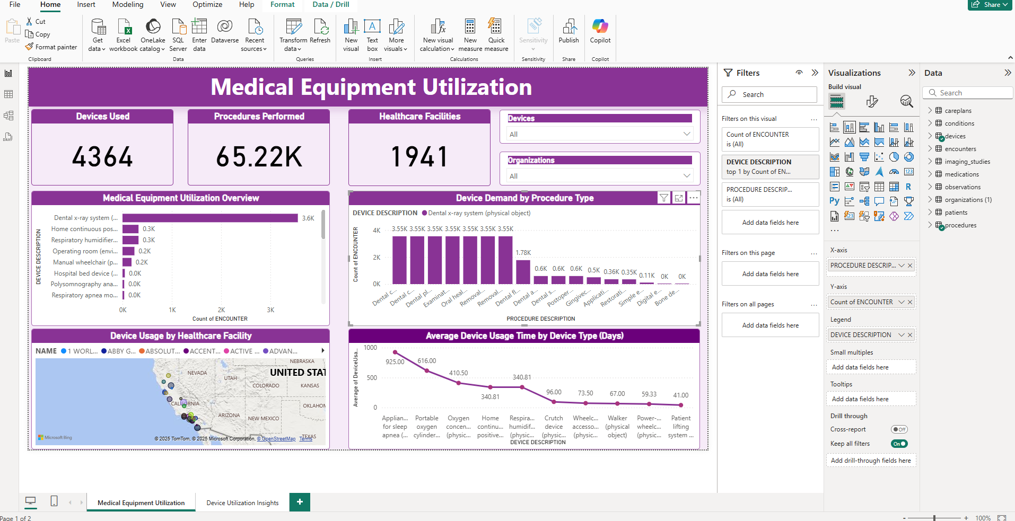
Device Demand by Procedure Type

Slide 10
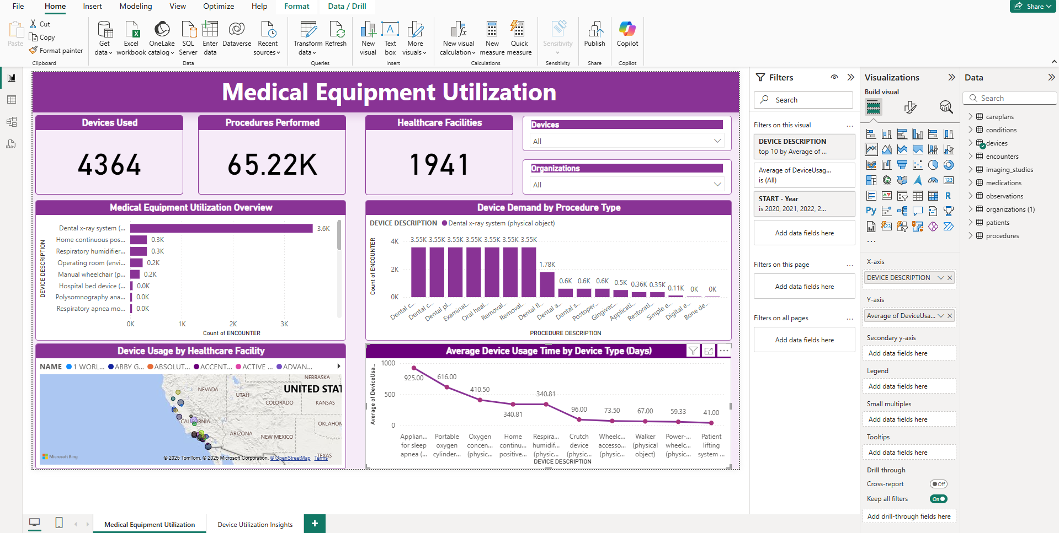
Average Device Usage Time

Slide 11
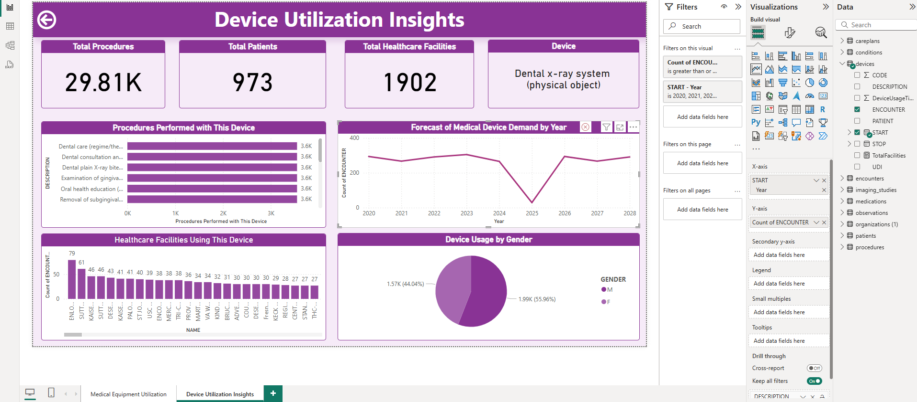
Forecast of Medical Device Demand

Slide 12
Thank you

